Slide 1
Waste Segregation Using AI
Image classification with EfficientNet-B0
3 waste categories
42,007 valid images
97.52% reported validation accuracy
Yalamanchili Vatsal (20233585)
Tanishq Gupta (20233290)
Tanishk Agrawal (20233289)
Vaibhav Singh (20233300)
Notes:
Opening, about 45 seconds. Our project classifies a single waste image into Biodegradable, Nonbiodegradable or Recyclable. We use an EfficientNetB0 model adapted through transfer learning, then expose it through a Streamlit upload interface. The goal is to support segregation decisions. The current prototype classifies images and does not operate physical sorting hardware.Source: README.md, waste_demo.py, NoteBooks/version_4_latest.ipynb.

Slide 2
Dataset and image preparation
Class
Train
Validation
Biodegradable
11,615
2,904
Non Biodegradable
11,017
2,755
Recyclable
10,972
2,744
Total
33,604
8,403
RGB images at 224 × 224. Stratified 80/20 split, seed 42.
Training augmentation: horizontal flips, rotation, zoom and contrast.
Float32 pixels stay at 0–255 to match EfficientNet preprocessing.
02
Notes:
Explain for about one minute. The saved V4 run lists 42,007 valid images across three classes. Each class receives its own random 80/20 split with seed 42, preserving class representation. Training uses 33,604 images and validation uses 8,403. Pillow checks readability, converts to RGB and resizes to 224 by 224 with bilinear interpolation. Pixel values remain float32 in the 0 to 255 range because EfficientNet includes preprocessing internally. Augmentation applies only during training. If asked about data leakage, say the code performs a stratified image split, but does not demonstrate duplicate or source-group separation. Source: V4 notebook cell 0 and saved output.

Slide 3
Model architecture and training
Architecture
Two-stage transfer learning
RGB image, 224 × 224x3
EfficientNetB0 with ImageNet weights
Global average pooling
Dropout 0.35, Dense 128 with ReLU
Dropout 0.25, Dense 3 with softmax
Stage 1: train the classifier
Frozen backbone, 8 epochs
Adam learning rate 0.001
Stage 2: fine-tune features
Last 50 layers, BatchNorm frozen
20 epochs, initial rate 0.00001
Batch size 32. Best checkpoint by validation accuracy.
Early stopping and learning-rate reduction monitor validation loss.
03

Slide 4
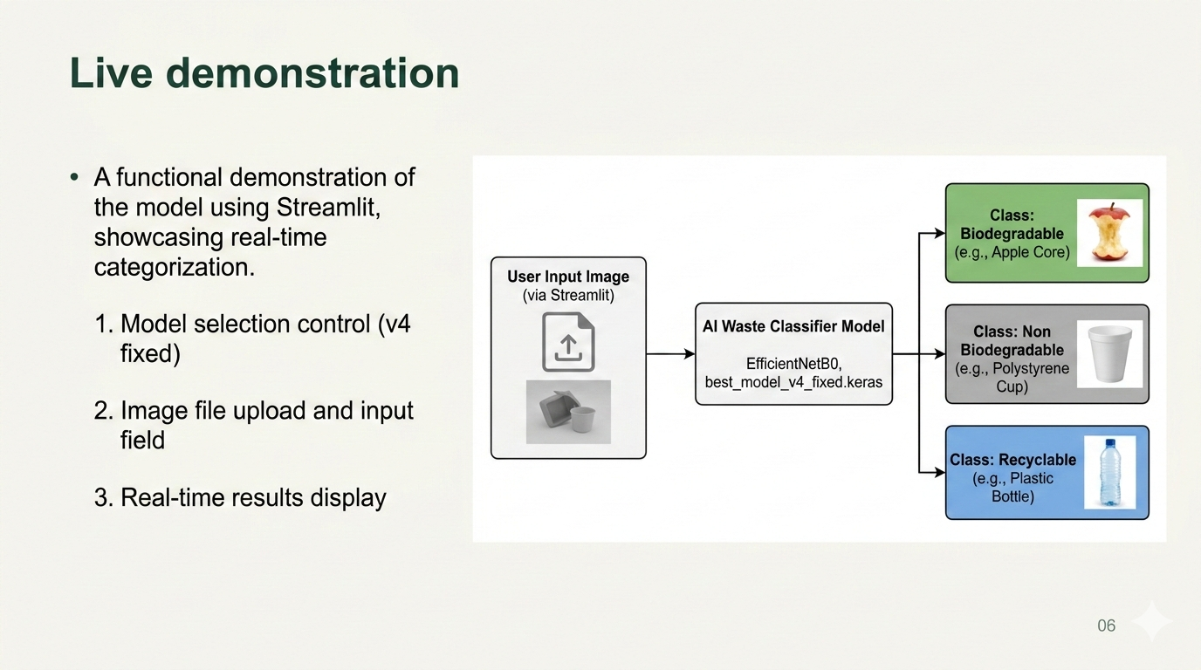

Slide 5
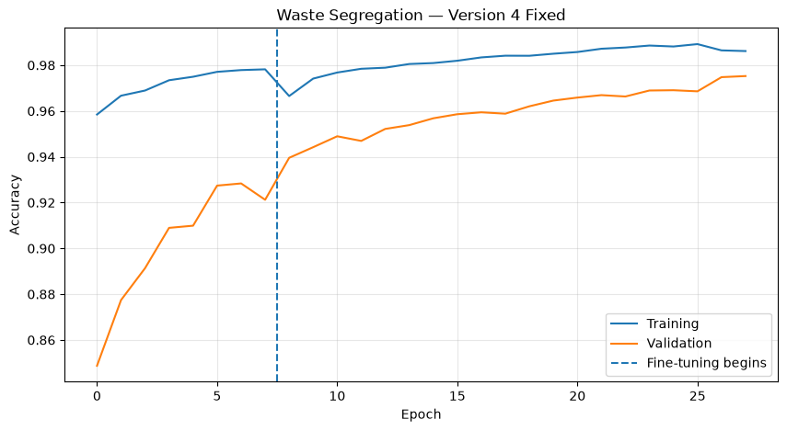
Validation results
92.84%
Best head-stage accuracy
97.52%
Best fine-tuned accuracy
+4.68 percentage points
Original saved notebook plot. Results use 8,403 validation images.
Checkpoint selection also uses this split. Independent test performance remains unmeasured.
04
Notes:
Explain for one minute. This is the original plot embedded in the V4 notebook. Head training achieved a best validation accuracy of 92.84 percent. Fine-tuning achieved 97.52 percent, an improvement of 4.68 percentage points from the rounded reported values. Final validation loss was 0.0863 in the saved log. These are validation results on the same split used to choose checkpoints, not an independent test score. The training curve can suggest convergence but cannot by itself establish real-world robustness. Avoid claiming the older V2 comparison is controlled because preprocessing and evaluation setup may differ. Source: V4 notebook saved outputs 4 and 5.

Slide 6
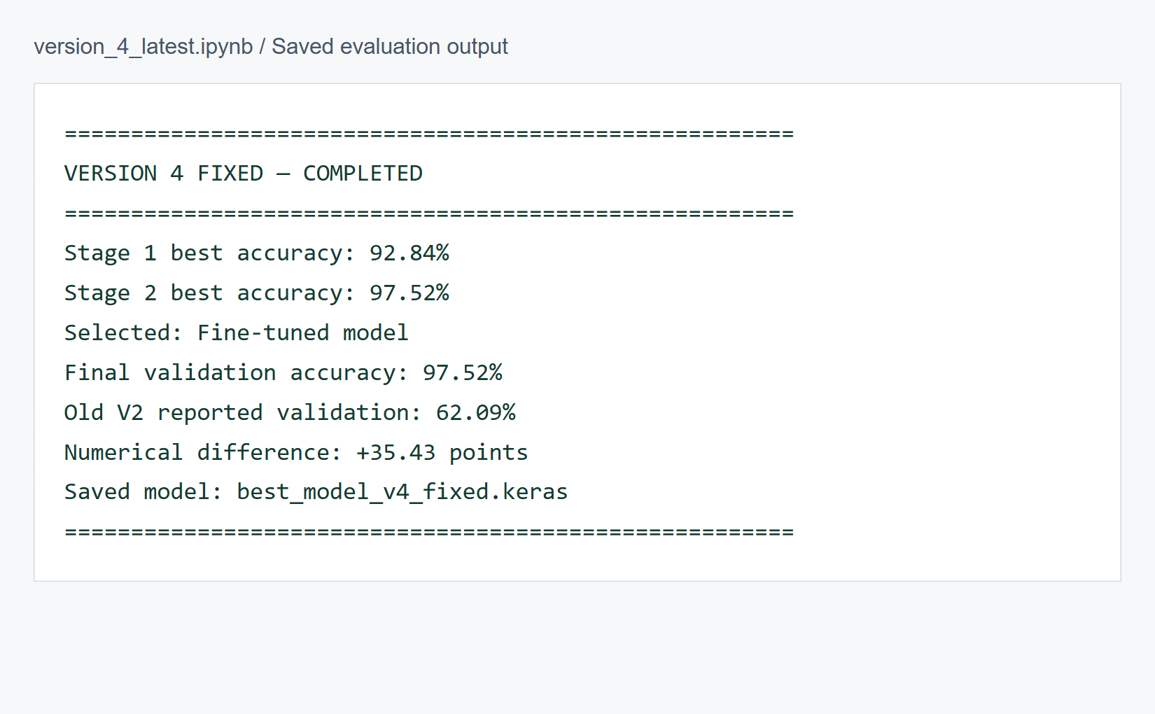
Saved result and demo workflow
Screenshot of saved evaluation output. Model: best_model_v4_fixed.keras
Demo scores are experimental and may be uncalibrated.
05
Notes:
Explain for one minute. The screenshot reproduces the final saved notebook evaluation output. The selected model is the fine-tuned checkpoint, saved as best_model_v4_fixed.keras. For the live demo, run the README Streamlit command in Python 3.12 with compatible Keras, upload one waste image and point out the predicted label and all three scores. The app converts to RGB, bilinear-resizes to 224 by 224 and keeps values in 0 to 255, matching training. Scores are softmax outputs and are not guaranteed to be calibrated probabilities. This screenshot is evaluation evidence from the saved notebook and is not a new app inference. Source: V4 notebook output and waste_demo.py, README.md.

